Slide 1

Unit 1 Introduction to DBMS
SY - A | Mr.Yogesh.K.Sharma
SY - B | Mrs.Leena A.Deshpande
SY - C | Mrs.Madhuri P.Karnik
SY - D | Mrs.Disha S. Wankhede
Department of Computer Engineering
BRACT’S, Vishwakarma Institute of Information Technology, Pune-48
(An Autonomous Institute affiliated to Savitribai Phule Pune University)
(NBA and NAAC accredited, ISO 9001:2015 certified)

Slide 2

CSUA22182 : Database Management System
Prerequisites :
Discrete Mathematics, Data Structure and Algorithms

Slide 3
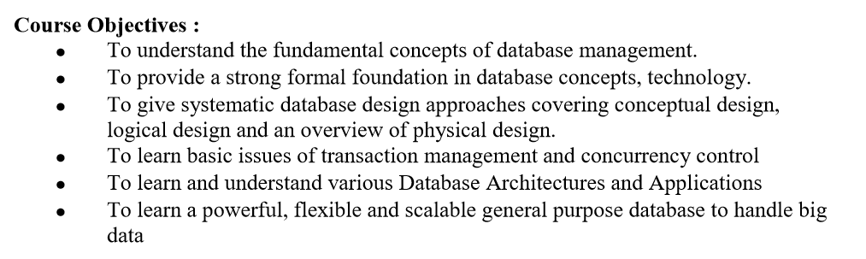
Course Objectives

Slide 4
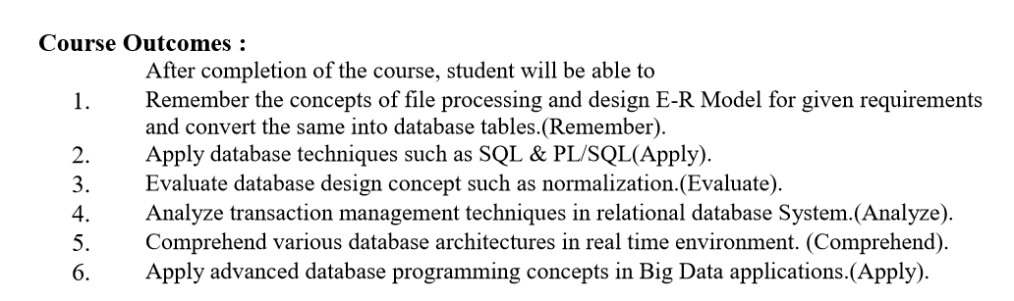
Course Outcomes

Slide 5
Text Books
1 Abraham Silberschatz ,HenryKorth , S.Sudarshan,"Database System concepts",5th Edition ,McGraw Hill International Edition.
2 Elmasri R., Navathe S., "Fundamentals of Database Systems", 4* Edition, PearsonEducation, 2003, ISBN 8129702282.
3 Pramod J. Sadalage and Martin Fowler, ―NoSQL Distilled‖, Addison Wesley, ISBN10: 0321826620, ISBN-13: 978-0321826626
4 “Managing and Using MySQL”, Reese G., Yarger R., King T., Williums H, 2nd Edition, Shroff Publishers and Distributors Pvt. Ltd., ISBN 81 - 7366 - 465 – X
5 MongoDB: The Definitive Guide by Kristina Chodorow

Slide 6
Reference Books
1 Ramkrishna R., Gehrke J., "Database Management Systems", 3rd Edition, McGrawHill, 2003, ISBN 0-07- 123151 –X.
2 C J Date, ―An Introduction to Database Systems‖, Addison-Wesley, ISBN: 0201144719.
3 Connally T., Begg C., "Database Systems", 3rd Edition, Pearson Education, 2002, ISBN 81-7808-861-4
4 MongoDB , O’Reilly Publications.
5 Hadoop, O’Reilly Publications.
6 http://docs.mongodb.org/manual/ or SQL/XML/MongoDB (https://www.w3schools.com/)

Slide 7
Continue Evaluation
CE Unit 1,2 –Quiz/Online /Offline ER Diagram (ERD) on any case study
CE Unit 3,4- Test Offline/Online
CE Unit 5,6- Quiz (Kahoot /Google Form)

Slide 8
Unit 1
Introduction to DBMS

Slide 9
Subject Importance
A database management system is important because it manages data efficiently and allows users to perform multiple tasks with ease.
Data can be categorized and structured to suit the needs of the company or organization.
Data is entered into the system and accessed on a routine basis by assigned users

Slide 10
Importance
Database helps in keeping the files in a systematic manner.
It helps in managing large amount of information in small time.
A database is an organized collection of data.
A relational database, more restrictively, is a collection of schemas, tables, queries, reports, views, and other elements manages

Slide 11
Top 10 Enterprise Database Systems of 2019
Oracle Database.
Oracle began its journey in 1979 as the first commercially available relational database management system (RDBMS). ...
Microsoft SQL Server. ...
IBM DB2. ...
SAP Sybase ASE. ...
PostgreSQL. ...
MariaDB Enterprise. ...
MySQL. ...
Teradata.
IBM Informix

Slide 12
What are the benefits of database management system?
Advantages of Database Management System
Reducing Data Redundancy.
The file based data management systems contained multiple files that were stored in many different locations in a system or even across multiple systems. ...
Sharing of Data. ...
Data Integrity. ...
Data Security. ...
Privacy. ...
Backup and Recovery. ...
Data Consistency.

Slide 13
Jobs in world
Database analysts and data administrators .
Oracle Database Administrator.
Database Administrator.
Data Science Engineer .
MongoDB Developer.
Microsoft SQL Server Database Administration.
Oracle Applications DBA.
Database Administrator - IT Security Design & Implementation.
PL-SQL Developer - SQL/Data Migration

Slide 14
Introduction
DBMS contains information about a particular enterprise
Collection of interrelated data
Set of programs to access the data
An environment that is both convenient and efficient to use
Database Applications:
Banking: transactions
Airlines: reservations, schedules
Universities: registration, grades
Sales: customers, products, purchases
Online retailers: order tracking, customized recommendations
Manufacturing: production, inventory, orders, supply chain
Human resources: employee records, salaries, tax deductions
Databases can be very large.
Databases touch all aspects of our lives

Slide 15
Introduction
Application program examples
Add new students, instructors, and courses
Register students for courses, and generate class rosters
Assign grades to students, compute grade point averages (GPA) and generate transcripts
In the early days, database applications were built directly on top of file systems

Slide 16
Advantages of a DBMS over file-processing Systems
Explain advantage of DBMS (System) over conventional file processing system.

Slide 17
Drawbacks of File system
Data redundancy(Duplication) : Data redundancy refers to the duplication of data, lets say we are managing the data of a college where a student is enrolled for two courses,
the same student details in such case will be stored twice, which will take more storage than needed.
Data redundancy often leads to higher storage costs and poor access time.

Slide 18
Drawbacks of File system .. Continue
Data inconsistency:
Data redundancy leads to data inconsistency, lets take the same example that we have taken above,
a student is enrolled for two courses and we have student address stored twice, now lets say student requests to change his address, if the address is changed at one place and not on all the records then this can lead to data inconsistency.

Slide 19
Drawbacks of File system .. Continue
Difficulty in accessing Data:
In Classical file organization the data is stored in the files.
Whenever data has to be retrieved as per the requirements then a new application program has to be written.
This is tedious process.

Slide 20
Drawbacks of File system .. Continue
Data Isolation:
Because data are scattered in various files, and files may be in different formats, writing new application programs to retrieve the appropriate data is difficult.

Slide 21
Drawbacks of File system .. Continue
Integrity Problem:
The data values stored in the database must satisfy certain types of consistency constraints.
For example, the balance of a bank account may never fall below a prescribed amount(Threshold Value ). These constraints are enforced in the system by adding appropriate code in the various application programs.
However, when new constraints are added, it is difficult to change the programs to enforce them. The problem is compounded when constraints involve several data items from different files.

Slide 22
Drawbacks of File system .. Continue
Atomicity issues:
Atomicity of a transaction refers to “All or nothing”, which means either all the operations in a transaction executes or none.
For example: Lets say Steve transfers 100$ to Negan’s account. This transaction consists multiple operations such as debit 100$ from Steve’s account, credit 100$ to Negan’s account.
like any other device, a computer system can fail lets say it fails after first operation then in that case Steve’s account would have been debited by 100$ but the amount was not credited to Negan’s account, in such case the rollback of operation should occur to maintain the atomicity of transaction. It is difficult to achieve atomicity in file processing systems.

Slide 23
Drawbacks of File system .. Continue
Data concurrency:
Concurrent access to data means more than one user is accessing the same data at the same time.
Anomalies occur when changes made by one user gets lost because of changes made by other user.
File system does not provide any procedure to stop anomalies. Whereas DBMS provides a locking system to stop anomalies to occur.

Slide 24
Drawbacks of File system .. Continue
Data Security:
Data should be secured from unauthorized access,
for example a student in a college should not be able to see the payroll details of the teachers, such kind of security constraints are difficult to apply in file processing systems.

Slide 25
Summary Drawbacks of File system over the DBMS
Data Redundancy
Data Inconsistency
Difficulty in accessing the data
Data Isolation
Integration Problem
Atomicity Issues
Data Concurrency
Data Security

Slide 26
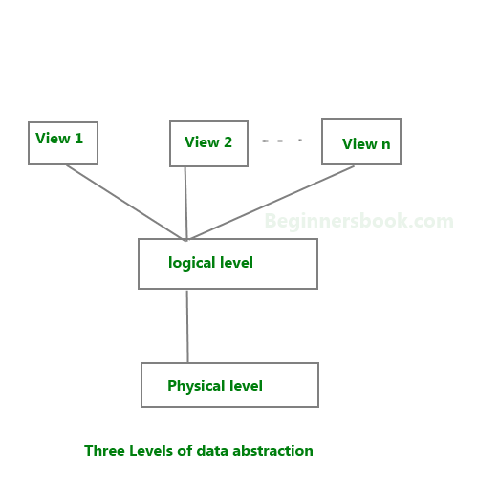
Data Abstraction
Database systems are made-up of complex data structures.
To ease the user interaction with database, the developers hide internal irrelevant details from users.
This process of hiding irrelevant details from user is called data abstraction.

Slide 27
Levels of Abstraction
Physical level:
This is the lowest level of data abstraction.
It describes how data is actually stored in database.
You can get the complex data structure details at this level.
Example:
Let’s say we are storing customer information in a customer table. At physical level these records can be described as blocks of storage (bytes, gigabytes, terabytes etc.) in memory. These details are often hidden from the programmers.

Slide 28
Levels of Abstraction…Continue
Logical level:
This is the middle level of 3-level data abstraction architecture.
It describes what data is stored in database.
At the logical level these records can be described as fields and attributes along with their data types, their relationship among each other can be logically implemented.
The programmers generally work at this level because they are aware of such things about database systems.

Slide 29
Levels of Abstraction…Continue
View level:
Application programs hide details of data types. Views can also hide information (e.g., salary) for security purposes.
At view level, user just interact with system with the help of GUI and enter the details at the screen, they are not aware of how the data is stored and what data is stored; such details are hidden from them.

Slide 30
Instances and Schemas
Definition of schema:
Design of a database is called the schema.
Schema is of three types: Physical schema, logical schema and view schema.
For example: In the following diagram, we have a schema that shows the relationship between three tables: Course, Student and Section.
The diagram only shows the design of the database, it doesn’t show the data present in those tables. Schema is only a structural view(design) of a database as shown in the diagram below.

Slide 31
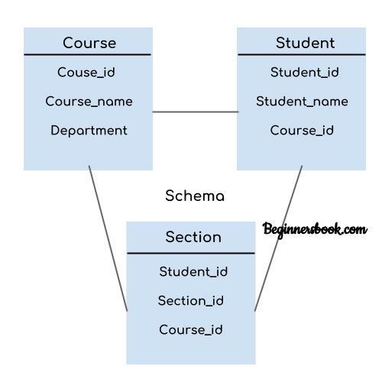
Instances and Schemas…Continue

Slide 32
Instances and Schemas…Continue
The design of a database at physical level is called physical schema, how the data stored in blocks of storage is described at this level.
Design of database at logical level is called logical schema, programmers and database administrators work at this level, at this level data can be described as certain types of data records gets stored in data structures.
Design of database at view level is called view schema. This generally describes end user interaction with database systems.

Slide 33
Instances and Schemas…Continue
Definition of instance:
The data stored in database at a particular moment of time is called instance of database.
Database schema defines the variable declarations in tables that belong to a particular database;
the value of these variables at a moment of time is called the instance of that database.

Slide 34
Instances and Schemas…Continue
For example, lets say we have a single table student in the database, today the table has 100 records, so today the instance of the database has 100 records. Lets say we are going to add another 100 records in this table by tomorrow so the instance of database tomorrow will have 200 records in table. In short, at a particular moment the data stored in database is called the instance, that changes over time when we add or delete data from the database.

Slide 35
Database Languages
Database languages are used to read, update and store data in a database. There are several such languages that can be used for this purpose; one of them is SQL (Structured Query Language).

Slide 36
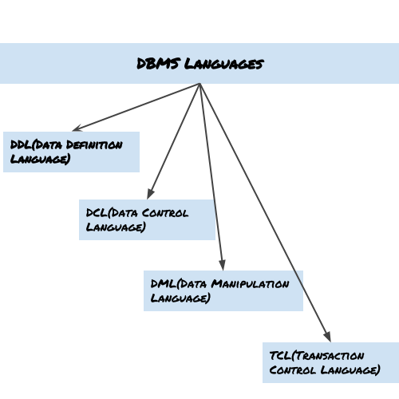
Database Languages…Continue

Slide 37
Database Languages…Continue
Data Definition Language (DDL)
DDL is used for specifying the database schema. It is used for creating tables, schema, indexes, constraints etc. in database. Lets see the operations that we can perform on database using DDL:
To create the database instance – CREATE
To alter the structure of database – ALTER
To drop database instances – DROP
To delete tables in a database instance – TRUNCATE
To rename database instances – RENAME
To drop objects from database such as tables – DROP
Note-All of these commands either defines or update the database schema that’s why they come under Data Definition language.

Slide 38
Database Languages…Continue
Data Manipulation Language (DML)
DML is used for accessing and manipulating data in a database. The following operations on database comes under DML:
To read records from table(s) – SELECT
To insert record(s) into the table(s) – INSERT
Update the data in table(s) – UPDATE
Delete all the records from the table – DELETE

Slide 39
Database Languages…Continue
Data Control language (DCL)
DCL is used for granting and revoking user access on a database –
To grant access to user – GRANT
To revoke or cancel access from user – REVOKE
Note-In practical data definition language, data manipulation language and data control languages are not separate language, rather they are the parts of a single database language such as SQL.

Slide 40
Database Languages…Continue
Transaction Control Language(TCL)
The changes in the database that we made using DML commands are either performed or rollbacked using TCL.
To persist the changes made by DML commands in database – COMMIT
To rollback the changes made to the database – ROLLBACK

Slide 41
What is Data Independence of DBMS?
Data Independence is defined as a property of DBMS that helps you to change the Database schema at one level of a database system without requiring to change the schema at the next higher level.
Data independence helps you to keep data separated from all programs that make use of it.

Slide 42
Data Independence…Continue
Types of Data Independence
In DBMS there are two types of data independence
Physical data independence
Logical data independence.
Levels of Database
The database has 3 levels as shown in the diagram below
Physical/Internal
Conceptual
External

Slide 43
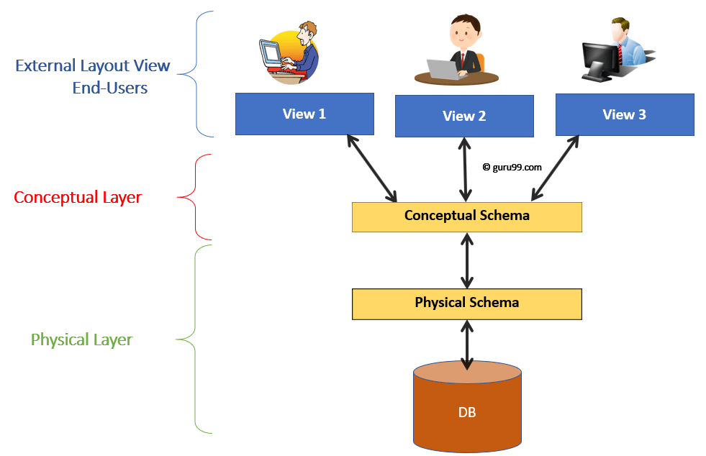
Data Independence…Continue

Slide 44
Data Independence…Continue
Physical Data Independence
Physical data independence helps you to separate conceptual levels from the internal/physical levels.
It allows you to provide a logical description of the database without the need to specify physical structures.
Compared to Logical Independence, it is easy to achieve physical data independence.
With Physical independence, you can easily change the physical storage structures or devices with an effect on the conceptual schema.
Any change done would be absorbed by the mapping between the conceptual and internal levels.

Slide 45
Data Independence…Continue
Examples of changes under Physical Data Independence
Due to Physical independence, any of the below change will not affect the conceptual layer.
Using a new storage device like Hard Drive or Magnetic Tapes
Modifying the file organization technique in the Database
Switching to different data structures.
Changing the access method.
Modifying indexes.
Changes to compression techniques or hashing algorithms.
Change of Location of Database from say C drive to D Drive

Slide 46
Data Independence…Continue
Logical Data Independence
Logical Data Independence is the ability to change the conceptual scheme without changing External views
External API or programs
Any change made will be absorbed by the mapping between external and conceptual levels.
When compared to Physical Data independence, it is challenging to achieve logical data independence.

Slide 47
Data Independence…Continue
Examples of changes under Logical Data Independence
Due to Logical independence, any of the below change will not affect the external layer.
Add/Modify/Delete a new attribute, entity or relationship is possible without a rewrite of existing application programs
Merging two records into one
Breaking an existing record into two or more records

Slide 48
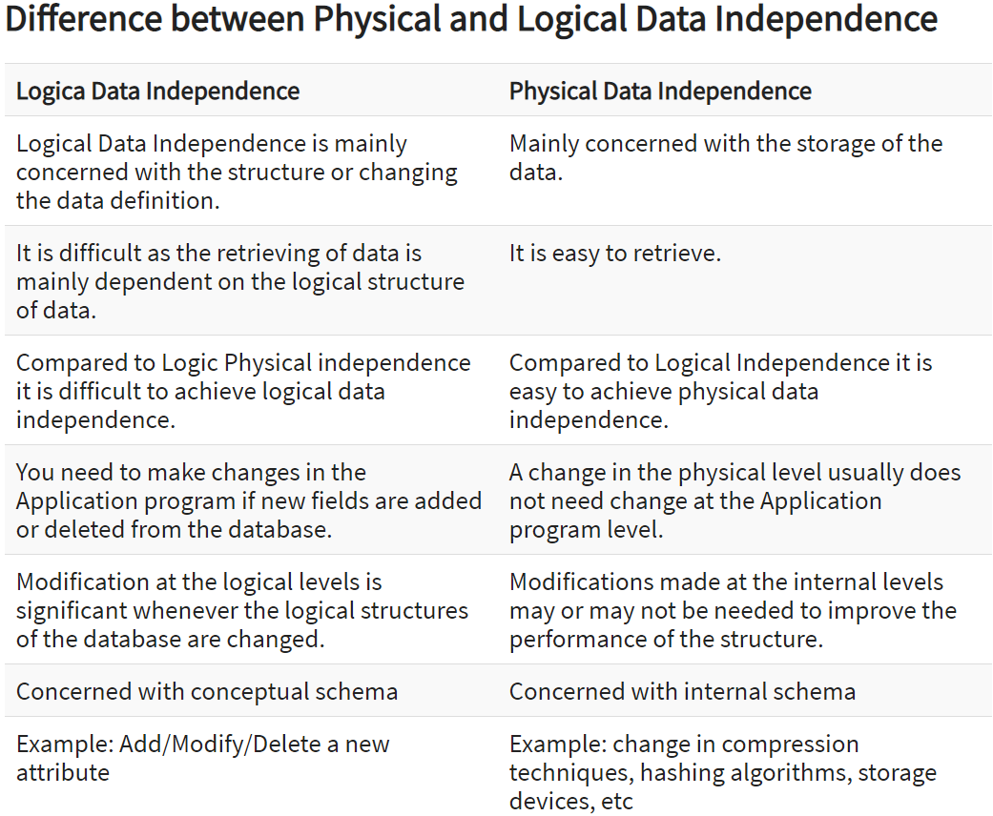

Slide 49
Data models
Data Model is a logical structure of Database. It describes the design of database to reflect entities, attributes, relationship among data, constrains etc.
Types of Data Models- 3 Types of Data Model
A>Object based logical Models – Describe data at the logical and view levels.
1.E-R Model
2.Object oriented Model

Slide 50
Data models Continue…
B>Record based logical Models – Like Object based model, they also describe data at the logical and view levels. These models specify logical structure of database with records, fields and attributes.
1.Relational Model-This model is simple and it has all the properties and capabilities required to process data with storage efficiency.
2.Hierarchical Model-A hierarchical database model is a data model in which the data are organized into a tree-like structure. ... The hierarchical database model mandates that each child record has only one parent, whereas each parent record can have one or more child records
3.Network Model – Network Model is same as hierarchical model except that it has graph-like structure rather than a tree-based structure. Unlike hierarchical model, this model allows each record to have more than one parent record.
C>Physical Data Model- These model are used to describe data at lowest level

Slide 51
Data models Continue…
1.Entity–relationship model (ER model)
ER Model describes the structure of a database with the help of a diagram, which is known as Entity Relationship Diagram (ER Diagram).
An ER model is a design or blueprint of a database that can later be implemented as a database.
The main components of E-R model are: entity set and relationship set.

Slide 52
What is an Entity Relationship Diagram (ER Diagram)?
An ER diagram shows the relationship among entity sets.
An entity set is a group of similar entities and these entities can have attributes.
In terms of DBMS, an entity is a table or attribute of a table in database, so by showing relationship among tables and their attributes, ER diagram shows the complete logical structure of a database.
Lets have a look at a simple ER diagram to understand this concept.

Slide 53
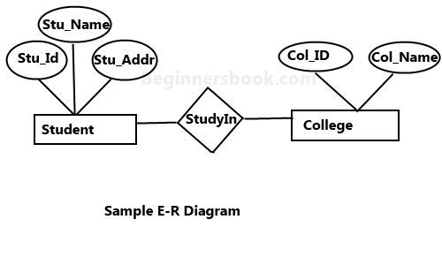
Data models Continue…
A simple ER Diagram:
In the following diagram we have two entities Student and College and their relationship. The relationship between Student and College is many to one as a college can have many students however a student cannot study in multiple colleges at the same time. Student entity has attributes such as Stu_Id, Stu_Name & Stu_Addr and College entity has attributes such as Col_ID & Col_Name

Slide 54
Components of the ER Diagram
This model is based on three basic concepts:
Entities
Attributes
Relationships
For example, in a University database, we might have entities for Students, Courses, and Lecturers. Students entity can have attributes like Rollno, Name, and DeptID. They might have relationships with Courses and Lecturers.

Slide 55
WHAT IS ENTITY?
A real-world thing either living or non-living that is easily recognizable and nonrecognizable. It is anything in the enterprise that is to be represented in our database. It may be a physical thing or simply a fact about the enterprise or an event that happens in the real world.
An entity can be place, person, object, event or a concept, which stores data in the database. The characteristics of entities are must have an attribute, and a unique key. Every entity is made up of some 'attributes' which represent that entity.
Examples of entities:
Person: Employee, Student, Patient
Place: Store, Building
Object: Machine, product, and Car
Event: Sale, Registration, Renewal
Concept: Account, Course

Slide 56
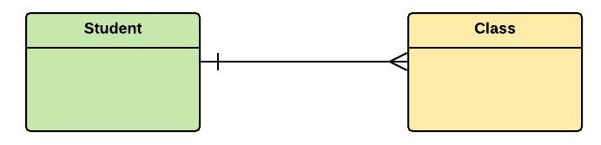
Entity set
Student
An entity set is a group of similar kind of entities. It may contain entities with attribute sharing similar values. Entities are represented by their properties, which also called attributes. All attributes have their separate values. For example, a student entity may have a name, age, class, as attributes.

Slide 57
Example of Entities:
A university may have some departments. All these departments employ various lecturers and offer several programs.
Some courses make up each program. Students register in a particular program and enroll in various courses.
A lecturer from the specific department takes each course, and each lecturer teaches a various group of students.

Slide 58
Relationship
Relationship is nothing but an association among two or more entities. E.g., Student study In College.
Entities take part in relationships. We can often identify relationships with verbs or verb phrases.
For example:
You are attending this lecture
I am giving the lecture
Just like entities, we can classify relationships according to relationship-types:
A student attends a lecture
A lecturer is giving a lecture.

Slide 59
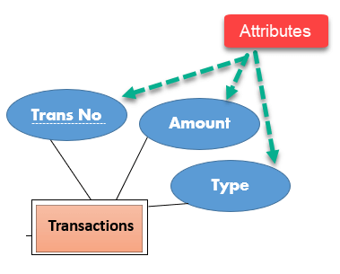
Attributes
It is a single-valued property of either an entity-type or a relationship-type.
For example, a lecture might have attributes: time, date, duration, place, etc.
An attribute is represented by an Ellipse

Slide 60
Types of Attributes
Types of Attributes | Description
Simple attribute | Simple attributes can't be divided any further. For example, a student's contact number. It is also called an atomic value.
Composite attribute | It is possible to break down composite attribute. For example, a student's full name may be further divided into first name, second name, and last name.
Derived attribute | This type of attribute does not include in the physical database. However, their values are derived from other attributes present in the database. For example, age should not be stored directly. Instead, it should be derived from the DOB of that employee.
Multivalued attribute | Multivalued attributes can have more than one values. For example, a student can have more than one mobile number, email address, etc.

Slide 61
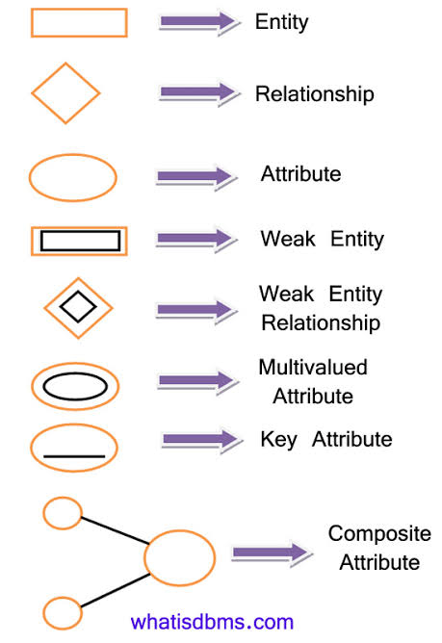

Slide 62
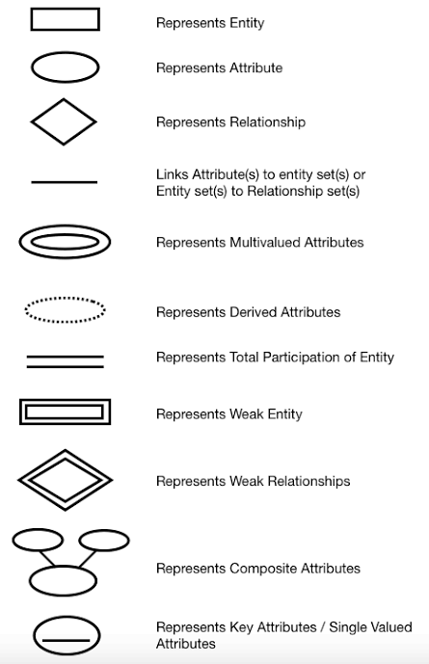

Slide 63
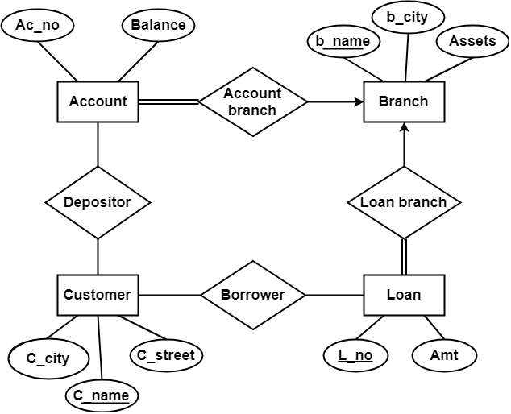

Slide 64
Solution-
Applying the rules that we have learnt, minimum 6 tables will be required-
Account (Ac_no , Balance , b_name)
Branch (b_name , b_city , Assets)
Loan (L_no , Amt , b_name)
Borrower (C_name , L_no)
Customer (C_name , C_street , C_city)
Depositor (C_name , Ac_no)

Slide 65
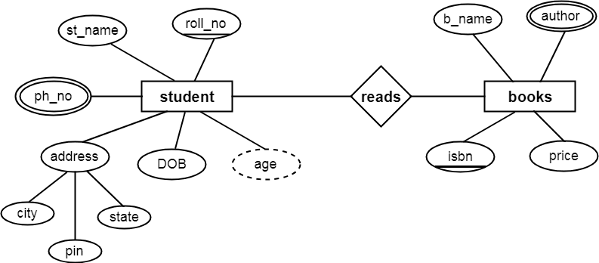
The double ellipse is used to define multivalued attributes and
the dashed ellipse is used for derived attributes

Slide 66
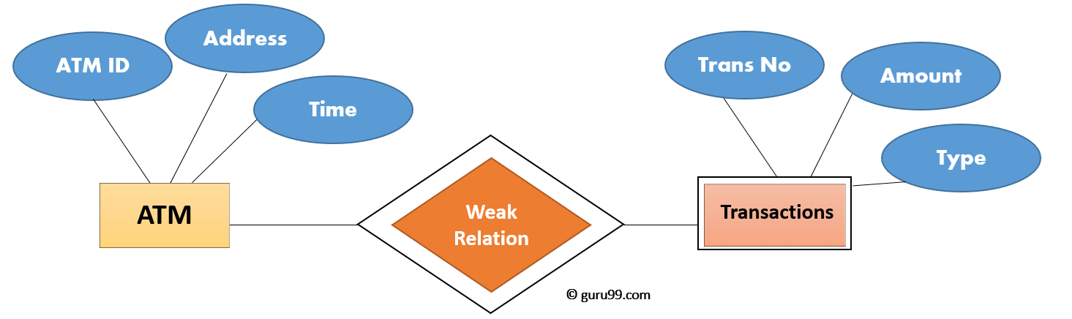
Weak Entities
A weak entity is a type of entity which doesn't have its key attribute. It can be identified uniquely by considering the primary key of another entity. For that, weak entity sets need to have participation.
In above example, "Trans No" is a discriminator within a group of transactions in an ATM.
Let's learn more about a weak entity by comparing it with a Strong Entity

Slide 67
Strong Entity Set | Weak Entity Set
Strong entity set always has a primary key. | It does not have enough attributes to build a primary key.
It is represented by a rectangle symbol. | It is represented by a double rectangle symbol.
It contains a Primary key represented by the underline symbol. | It contains a Partial Key which is represented by a dashed underline symbol.
The member of a strong entity set is called as dominant entity set. | The member of a weak entity set called as a subordinate entity set.
Primary Key is one of its attributes which helps to identify its member. | In a weak entity set, it is a combination of primary key and partial key of the strong entity set.
In the ER diagram the relationship between two strong entity set shown by using a diamond symbol. | The relationship between one strong and a weak entity set shown by using the double diamond symbol.
The connecting line of the strong entity set with the relationship is single. | The line connecting the weak entity set for identifying relationship is double.

Slide 68
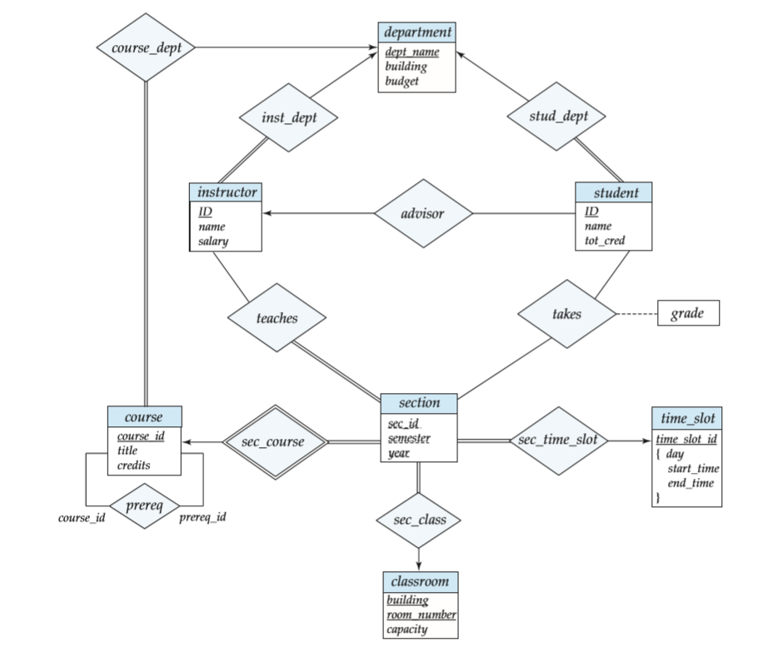
E-R diagram for the University Enterprise

Slide 69
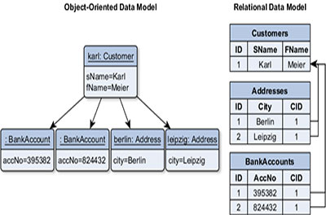
Object Oriented Data Model

Slide 70
Relational Model
The relational model uses a collection of tables to represent both data and the relationships among those data.
Each table has multiple columns, and each column has a unique name.
Tables are also known as relations.
The relational model is an example of a record-based model.
Record-based models are so named because the database is structured in ﬁxed-format records of several types.
Each table contains records of a particular type. Each record type deﬁnes a ﬁxed number of ﬁelds, or attributes. The columns of the table correspond to the attributes of the record type

Slide 71
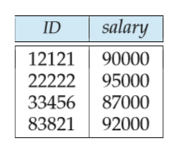
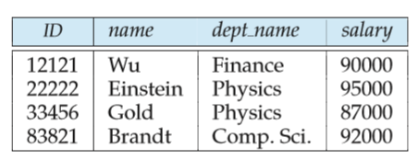
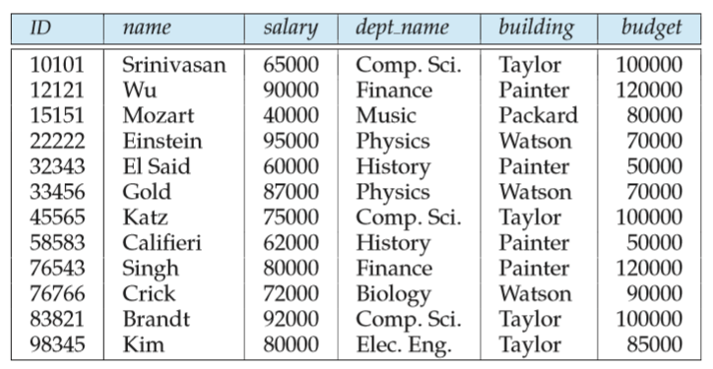

Slide 72
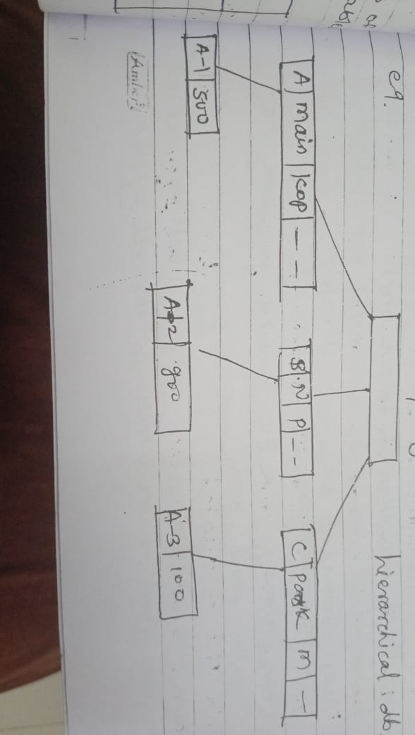
Hierarchical Model

Slide 73
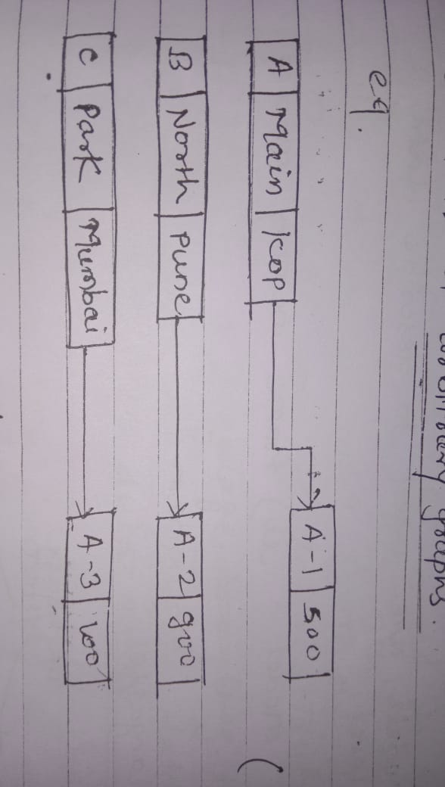
Network Model

Slide 74
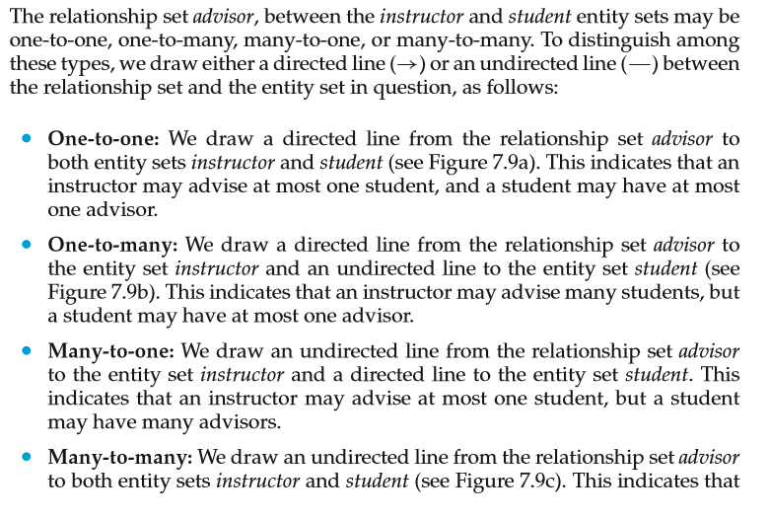
Mapping Cardinality

Slide 75
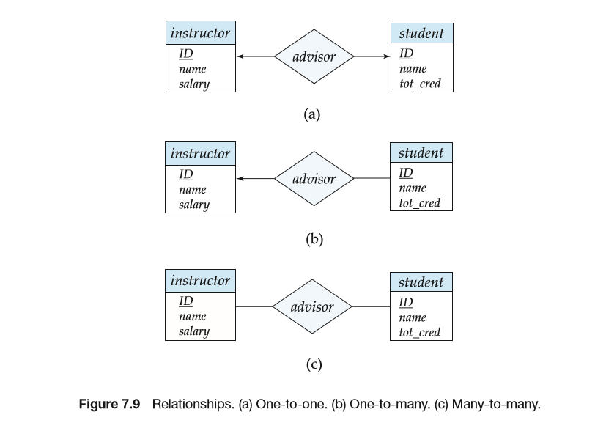
(One) / (Many)

Slide 76
Generalization –
Generalization is the process of extracting common properties from a set of entities and create a generalized entity from it.
It is a bottom-up approach in which two or more entities can be generalized to a higher level entity if they have some attributes in common.
For Example, STUDENT and FACULTY can be generalized to a higher level entity called PERSON as shown in Figure . In this case, common attributes like P_NAME, P_ADD become part of higher entity (PERSON) and specialized attributes like S_FEE become part of specialized entity (STUDENT).

Slide 77
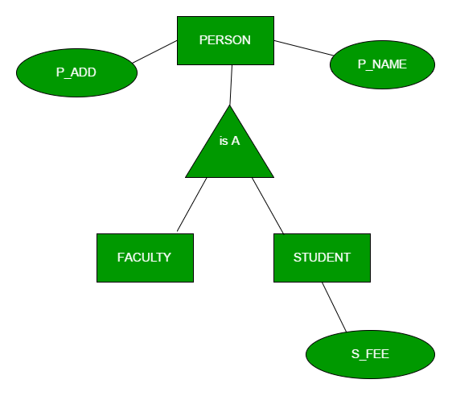
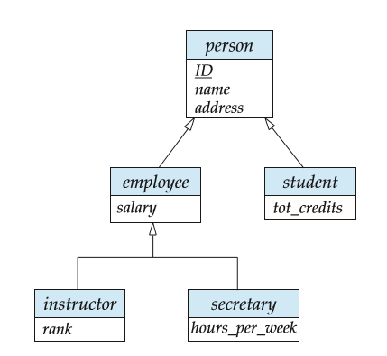

Slide 78
Specialization
An entity is divided into sub-entities based on their characteristics.
It is a top-down approach where higher level entity is specialized into two or more lower level entities.
For Example, EMPLOYEE entity in an Employee management system can be specialized into DEVELOPER, TESTER etc. as shown in Figure . In this case, common attributes like E_NAME, E_SAL etc. become part of higher entity (EMPLOYEE) and specialized attributes like TES_TYPE become part of specialized entity (TESTER).

Slide 79
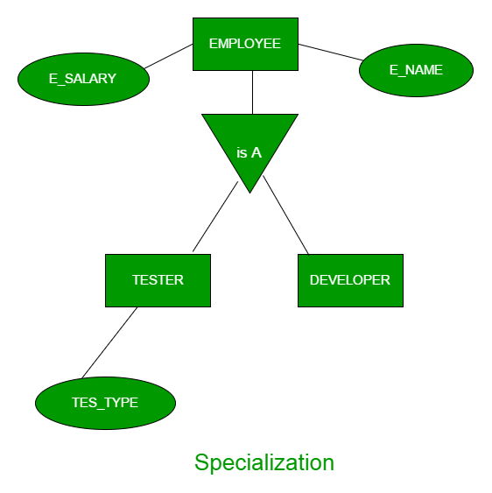

Slide 80
Aggregation
An ER diagram is not capable of representing relationship between an entity and a relationship which may be required in some scenarios. In those cases, a relationship with its corresponding entities is aggregated into a higher level entity.
For Example A binary relationship eval_for between proj_guide and evaluation to represent which (student, project, instructor) combination an evaluation

Slide 81
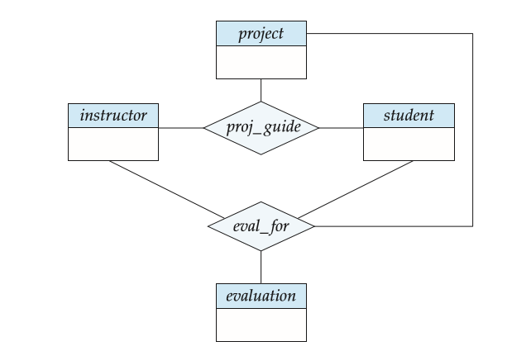

Slide 82
Overall DBMS-Architecture

Slide 83
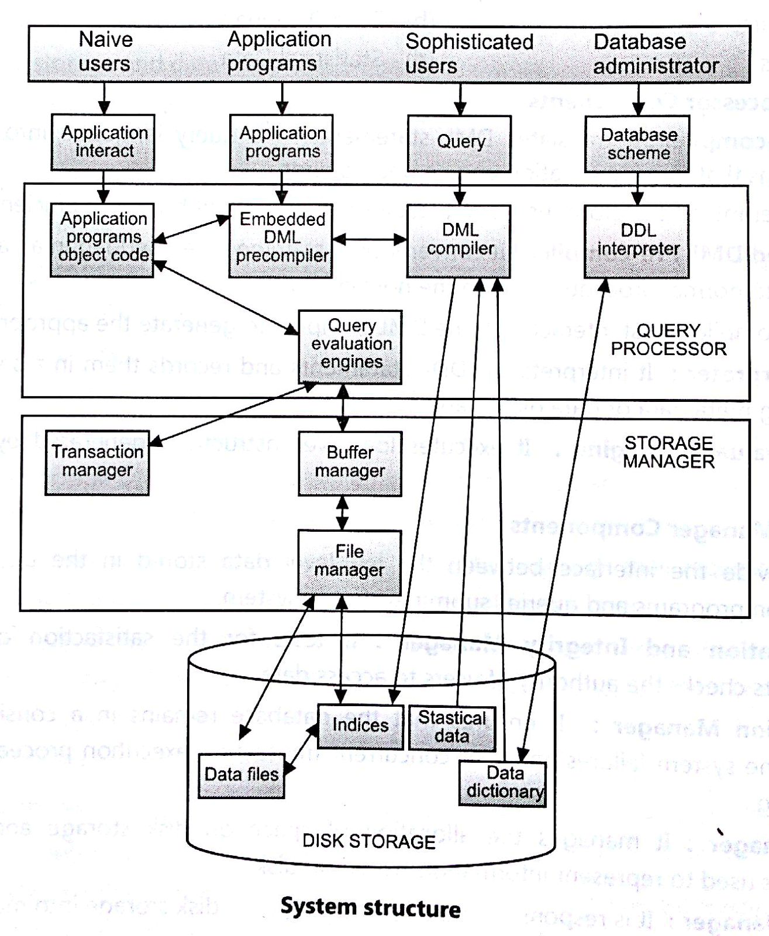

Slide 84
Database Users:
Users are differentiated by the way they expect to interact with the system:
Application programmers:
Application programmers are computer professionals who write application programs. Application programmers can choose from many tools to develop user interfaces.
Rapid application development (RAD) tools are tools that enable an application programmer to construct forms and reports without writing a program.
Sophisticated users:
Sophisticated users interact with the system without writing programs. Instead, they form their requests in a database query language.
They submit each such query to a query processor, whose function is to break down DML statements into instructions that the storage manager understands.

Slide 85
Specialized users :
Specialized users are sophisticated users who write specialized database applications that do not fit into the traditional data-processing framework.
Among these applications are computer-aided design systems, knowledge base and expert systems, systems that store data with complex data types (for example, graphics data and audio data)
Naïve users :
Naive users are unsophisticated users who interact with the system by invoking one of the application programs that have been written previously.
For example, a bank teller who needs to transfer $50 from account A to account B invokes a program called transfer. This program asks the teller for the amount of money to be transferred, the account from which the money is to be transferred, and the account to which the money is to be transferred.

Slide 86
Database Administrator:
Coordinates all the activities of the database system. The database administrator has a good understanding of the enterprise’s information resources and needs.
Database administrator's duties include:
Schema definition: The DBA creates the original database schema by executing a set of data definition statements in the DDL.
Storage structure and access method definition.
Schema and physical organization modification: The DBA carries out changes to the schema and physical organization to reflect the changing needs of the organization, or to alter the physical organization to improve performance.
Granting user authority to access the database: By granting different types of authorization, the database administrator can regulate which parts of the database various users can access.
Specifying integrity constraints.
Monitoring performance and responding to changes in requirements.

Slide 87
Query Processor:
The query processor will accept query from user and solves it by accessing the database.
Parts of Query processor:
DDL interpreter
This will interprets DDL statements and fetch the definitions in the data dictionary.
DML compiler
a. This will translates DML statements in a query language into low level instructions that the query evaluation engine understands.
b. A query can usually be translated into any of a number of alternative evaluation plans for same query result. DML compiler will select best plan for query optimization.
Query evaluation engine
This engine will execute low-level instructions generated by the DML compiler on DBMS.

Slide 88
Storage Manager/Storage Management:
A storage manager is a program module which acts like interface between the data stored in a database and the application programs and queries submitted to the system.
Thus, the storage manager is responsible for storing, retrieving and updating data in the database.
The storage manager components include:
Authorization and integrity manager: Checks for integrity constraints and authority of users to access data.
Transaction manager: Ensures that the database remains in a consistent state although there are system failures.
File manager: Manages the allocation of space on disk storage and the data structures used to represent information stored on disk.
Buffer manager: It is responsible for retrieving data from disk storage into main memory. It enables the database to handle data sizes that are much larger than the size of main memory.
Data structures implemented by storage manager.
Data files: Stored in the database itself.
Data dictionary: Stores metadata about the structure of the database.
Indices: Provide fast access to data items.

Slide 89
Prime and Non Prime Attributes in DBMS with Example
Prime Attributes –
Attribute set that belongs to any candidate key are called Prime Attributes. (union of all the candidate key attribute) {CK1 ∪ CK2 ∪ CK3 ∪ ……} If Prime attribute determined by other attribute set, then more than one candidate key is possible.
For example, If A is Candidate Key, and X→A, then, X is also Candidate Key
Non Prime Attribute – Attribute set does not belongs to any candidate key are called Non Prime Attributes.

Slide 90
Modelling Temporal Data
Temporal database stores data relating to time instances. It offers temporal data types and stores information relating to past, present and future time.
Temporal databases provide a uniform and systematic way of dealing with historical data.
More specifically the temporal aspects usually include valid time and transaction time. These attributes can be combined to form bitemporal data.
Valid time is the time period during which a fact is true in the real world.(Historical database)
Transaction time is the time period during which a fact stored in the database was known.(Rollback database)
Bitemporal data combines both Valid and Transaction Time.

Slide 91
Example:-Imagine that we come up with a temporal database storing data about the 18th century. The valid time of these facts is somewhere between 1700 and 1799, where as the transaction time starts when we insert the facts into the database, for example, January 21, 1998.
Consider data about employees with respect to the real world is stored in table.
Then, the following table could result:

Slide 92
EmpID | Name | Department | Salary | ValidTimeStart | ValidTimeEnd
10 | John | Research | 11000 | 1985 | 1990
10 | John | Sales | 11000 | 1990 | 1993
10 | John | Sales | 12000 | 1993 | INF
11 | Paul | Research | 10000 | 1988 | 1995
12 | George | Research | 10500 | 1991 | INF

Slide 93
The above valid-time table stores the history of the employees with respect to the real world. The attributes ValidTimeStart and ValidTimeEnd actually represent a time interval which is closed at its lower and open at its upper bound.
Thus, we see that during the time period [1985 - 1990), employee John was working in the research department, having a salary of 11000.
Then he changed to the sales department, still earning 11000. In 1993, he got a salary raise to 12000.
The upper bound INF denotes that the tuple is valid until further notice. It is now possible to store information about past states.
We see that Paul was employed from 1988 until 1995. In the corresponding non-temporal table, this information was (physically) deleted when Paul left the company.

Slide 94
Different Forms of Temporal Databases
The two different notions of time - valid time and transaction time - allow the distinction of different forms of temporal databases.
A historical database stores data with respect to valid time, a rollback database stores data with respect to transaction time.
A bitemporal database stores data with respect to both valid time and transaction time.
Commercial DBMS are said to store only a single state of the real world, usually the most recent state. Such databases usually are called snapshot databases.
A snapshot database in the context of valid time and transaction time is depicted in the following picture:

Slide 95
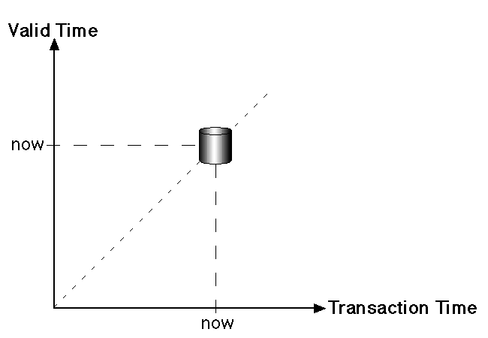

Slide 96
On the other hand, a bitemporal DBMS such as TimeDB stores the history of data with respect to both valid time and transaction time.
The history of when data was stored in the database (transaction time) is limited to past and present database states, since it is managed by the system directly which does not know anything about future states.
A table in the bitemporal relational DBMS TimeDB may either be a snapshot table (storing only current data), a valid-time table (storing when the data is valid wrt. the real world), a transaction-time table (storing when the data was recorded in the database) or a bitemporal table (storing both valid time and transaction time).

Slide 97
An extended version of SQL allows to specify which kind of table is needed when the table is created.
Existing tables may also be altered (schema versioning). Additionally, it supports temporal queries, temporal modification statements and temporal constraints.
The states stored in a bitemporal database are shown in fig.
Of course, a temporal DBMS such as TimeDB does not store each database state separately as depicted in the figure, it stores valid time and/or transaction time for each tuple.

Slide 98
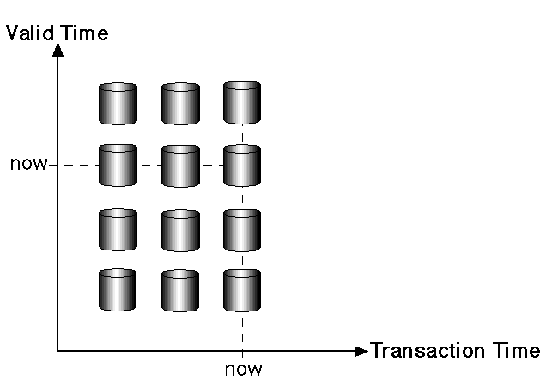

Slide 99
References
Abraham Silberschatz ,HenryKorth , S.Sudarshan,"Database System concepts",5th Edition ,McGraw Hill International Edition
http://www.timeconsult.com/TemporalData/TemporalDB.html
http://punarvasi.com/different-types-of-database-users/

Slide 100
END

